Slide 1
Application Software
Presented by
Syed Shakil Mahmud
Lecturer
Department of Computer Science and Engineering
Bangladesh Army International University of Science and Technology

Slide 2
Learning Objectives
Describe what application software is, the different types of ownership rights, and the difference between installed and cloud software.
Detail some concepts and commands that many software programs have in common.
Discuss word processing and explain what kinds of documents are created using this type of program.
Explain the purpose of spreadsheet software and the kinds of documents created using this type of program.

Slide 3
Learning Objectives
Identify some of the vocabulary used with database software and discuss the benefits of using this type of program.
Describe what presentation graphics and electronic slide
shows are and when they might be used.
List some types of graphics and multimedia software that
consumers use frequently.
Name several other types of application software programs and discuss what functions they perform.

Slide 4
Overview
This chapter covers:
General characteristics of application software
The most widely used types of application software,
including:
Word processing
Spreadsheet
Database
Presentation graphics
Graphics and multimedia software
Overview of other types of application software

Slide 5
The Basics of Application Software
Software Ownership Rights
Specify the allowable use of the program
Software license
Gives you the right to use a software program
Specifies the conditions under which the buyer can use
the software
Open source software
Programs with source code made available to the
general public

Slide 6
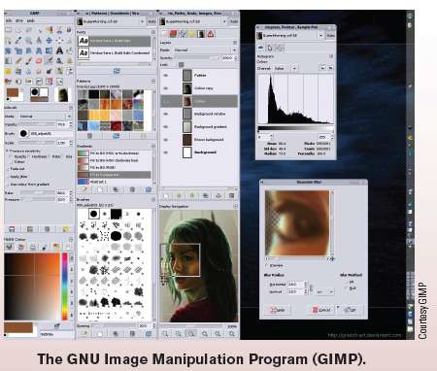
Inside the Industry Box
Open Source Software
Use is growing
In addition to Linux and other open source operating
systems, there are many open source apps
Open source is typically
cheaper
Can also be more stable and
secure

Slide 7
The Basics of Application Software
Commercial Software
Copyrighted software developed and sold for profit
Typically comes with a single-user license
Shareware
Copyrighted software distributed on the honor system
Consumers should either pay for it or uninstall it after the trial
period
Freeware
Copyrighted software programs that are given away by the
author for others to use free of charge
Public Domain Software
Software that is not copyrighted and ownership rights have been donated to the public domain

Slide 8
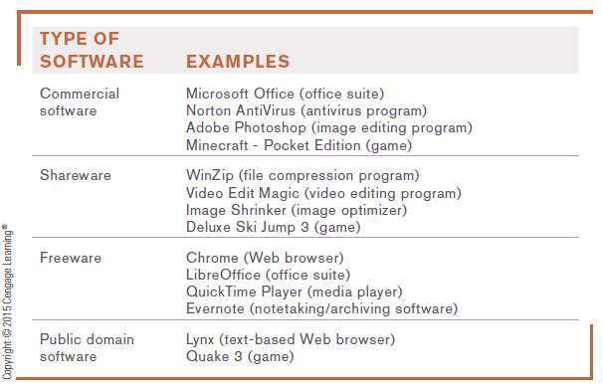

The Basics of Application Software

Slide 9
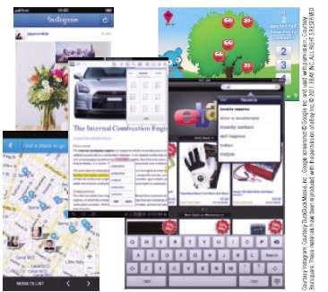

Desktop vs. Mobile Software
Personal computers use desktop software
Smartphones and other mobile devices typically require mobile software called apps
Specifically designed for a specific type of device
Wide range of software available via app stores (Google Play, Apple App Store, etc.)

Slide 10
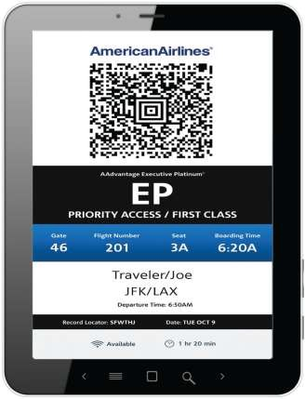
Technology and You Box
Mobile Ticketing
Download ticket to mobile device to use for admittance
Tickets for movies, sporting events, concerts, etc.
Boarding passes
Custom tickets
10

Slide 11
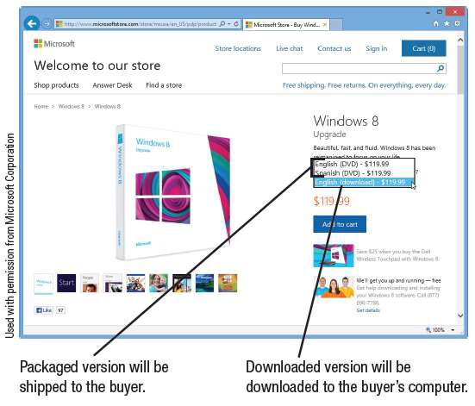
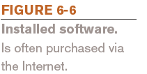
Installed vs. Cloud Software
Installed Software
Must be installed on the computer before it can be run
Can be purchased in
physical form
Can be downloaded from the Internet

Slide 12
Installed vs. Cloud Software
Cloud Software
Is delivered on-demand via the Web
Also called Software as a Service (SaaS) and cloudware
Includes free software and fee-based software
Advantages of cloud software
Files can be accessed from any computer with an
Internet connection
Ease of implementation
Improved collaboration capabilities
Always working with the most current version of software

Slide 13
Installed vs. Cloud Software
Potential disadvantages of cloud software
Online applications tend to run more slowly
Have file size limits
Cost may eventually exceed the cost of purchasing a similar installed version of the software

Slide 14
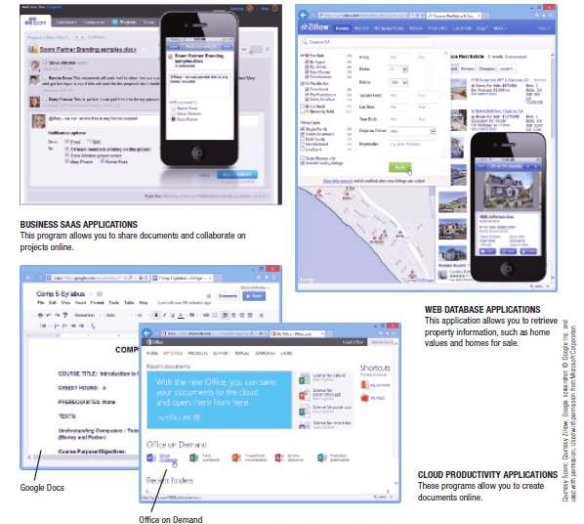

Installed vs. Cloud Software

Slide 15

Trend Box
Airline Apps
American Airlines is issuing media tablets to all cabin
personnel and iPads to all pilots
Replaces paper manuals and maps
Expected to be able to provide passengers with additional services such as connection and weather info and food purchases and other in-flight transactions

Slide 16
Software Suites
Software Suites
Collection of software programs bundled together and sold
as a single software package
Office suites are used by most businesses/individuals to produce documents and typically include:
Word processing software
Spreadsheet software
Database software
Presentation graphics-software
Provide a common interface among programs in the suite

Slide 17
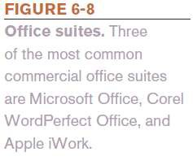
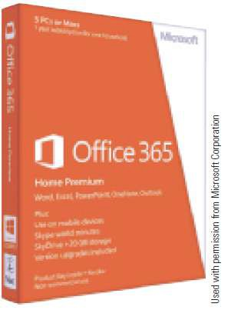
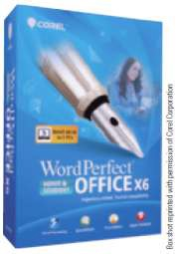
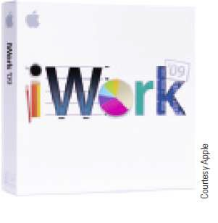
Software Suites
Latest version of Office is 2013 (traditional installed)/365 (subscription)
Office on Demand
Read mode

Slide 18

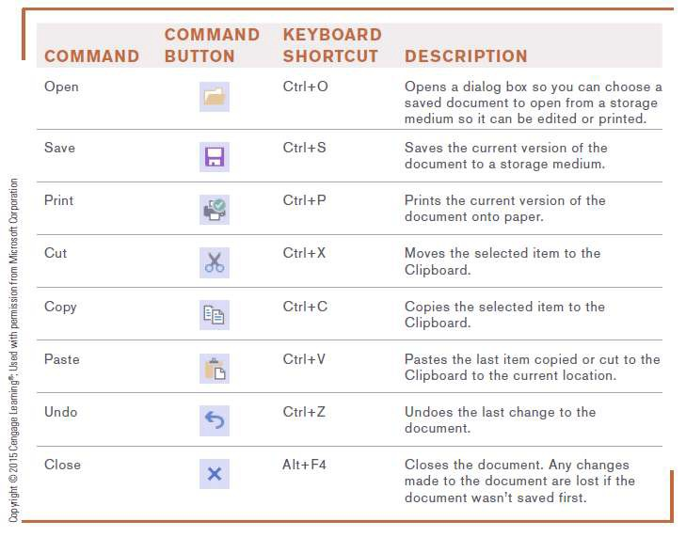
Common Software Commands
Toolbars, Menus, Keyboard Shortcuts, and the Ribbon
Provide access to most commands in application programs
Keyboard shortcuts
can be used

Slide 19
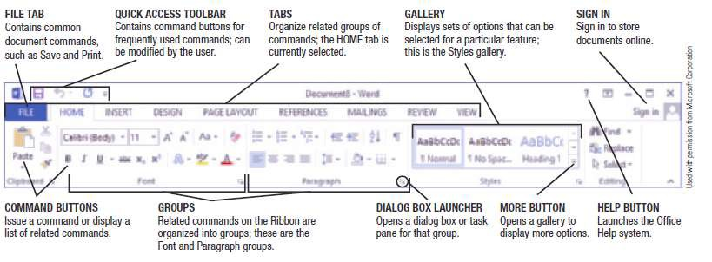

Common Software Commands
Ribbon used in Microsoft Office 2007 and later
Commands are organized into groups located on tabs
Contextual tabs appear on the Ribbon as needed and contain special commands

Slide 20
Common Software Commands
Editing a Document
Changing the content of the document, such as inserting or deleting words
Insertion point
Indicates the current location in a document, which is where the changes will be made
Typing text inserts the text at the insertion point location
Delete and Backspace keys delete text
Text and objects can typically be selected and moved, copied, deleted, or formatted
20

Slide 21
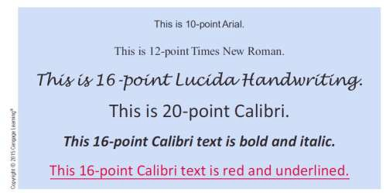
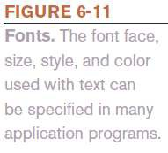
Common Software Commands
Formatting a Document
Changes the appearance of the document
Changes font face, font size, and/or font color
Changes line spacing or margins
Adds page numbers and/or borders

Slide 22
Common Software Commands
Getting Help
Often built into the program and typically contains:
Table of Contents
Browsing
Search
Online help (via manufacturer’s Web site and independent
sites)
Offline help (periodicals, books, tutorial videos, classes)

Slide 23
Quick Quiz
Software programs that are distributed on the honor system and can be legally and ethically shared with others to try out the software are referred to as .
shareware programs
commercial software
public domain software
True or False: Software purchased via the Internet is always in
downloaded, not packaged, form.
A group of related software programs sold together as one unit is called a(n) .
Answers:
1) a; 2) False; 3) software suite

Slide 24
Word Processing Concepts
What Is Word Processing?
Using a computer and word processing software to create, edit, save, and print written documents such as letters, contracts, and manuscripts
Common Word Processing Software Programs
Microsoft Word
Corel WordPerfect
Apple Pages

Slide 25
Word Processing Concepts
Creating a Word Processing Document
Word wrap
Automatically returns the insertion point to the next
line when the end of the screen line is reached
Character formatting (font face, size, style, or color)
Paragraph formatting (line spacing, indentation, alignment,
and styles)
Page formatting (margins, paper size, orientation, headers,
footers, etc.)
Document formatting (footnotes, end notes, table of contents, index, background, theme)

Slide 26
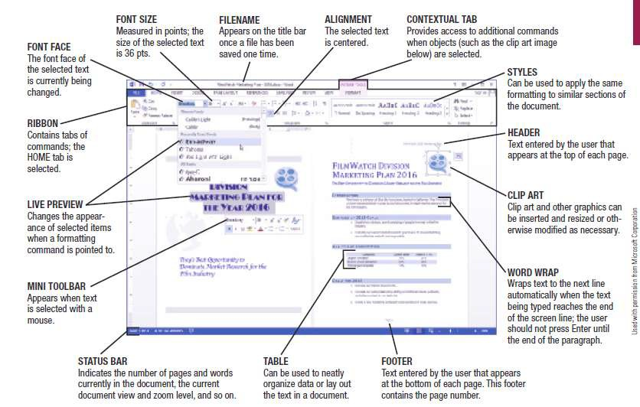

Word Processing Concepts

Slide 27
Word Processing Concepts
Tables, Graphics, and Templates
Tables
Allow content to be organized in a table consisting of
rows and columns
Graphics or Drawing Features
Allow images to be inserted into a document (clip art,
photographs, drawn images, etc.) and then modified
Templates
Help users create new documents quickly

Slide 28
Word Processing Concepts
Word Processing and the Web
Most word processing programs today include Web-
related features allowing you to:
Send a document as an e-mail message
Include Web page hyperlinks in documents
Create or modify Web pages
Create and publish blogs
Collaborate with others online

Slide 29
Spreadsheet Concepts
What Is a Spreadsheet?
Documents containing a group of numbers and other data
organized into rows and columns
Spreadsheet software includes the following tools
Formulas, data analysis tools, charts, and graphs
Most widely used spreadsheet programs:
Microsoft Excel
Corel Quattro Pro
Apple Numbers
30

Slide 30
Spreadsheet Concepts
Creating a Spreadsheet
Worksheet: a single spreadsheet
Workbook: a collection of worksheets saved in a single file
Worksheets are divided into rows and columns
Cell
The intersection of a row and a column
Each cell is identified by a cell address, such as A1
Cell pointer is used to select a cell
Cell pointer can be used to select more than one cell (range or block)

Slide 31
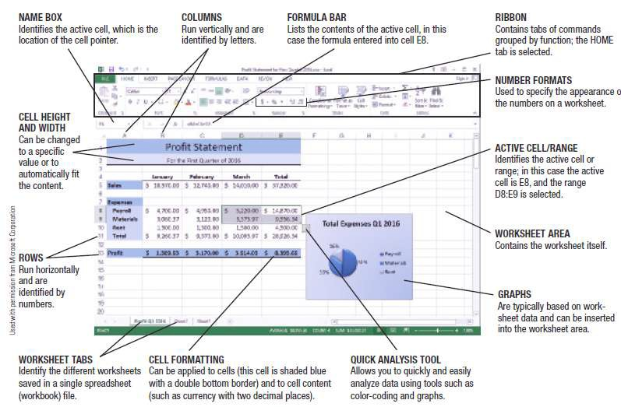

Spreadsheet Concepts

Slide 32
Spreadsheet Concepts
Entering Data into a Spreadsheet Cell
Labels
Text-based entry in a worksheet cell that identifies data on the worksheet
Constant Values
Numerical entry in a worksheet cell
Formulas
Perform mathematical operations on the content of other cells
Usually reference the cell address, not the current data in a cell
Use mathematical operators; begin with an = sign

Slide 33
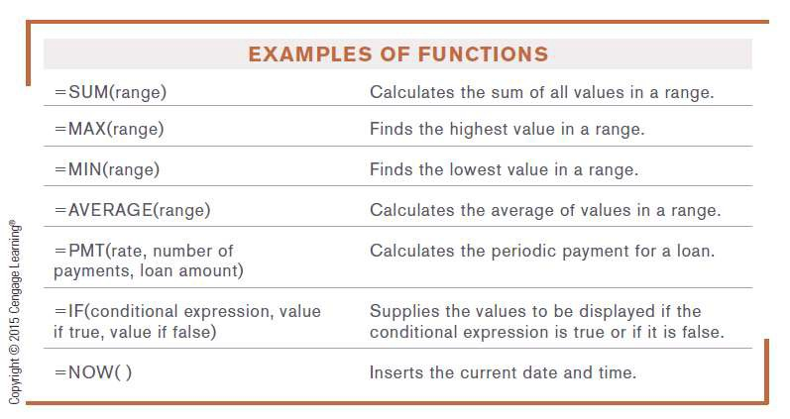
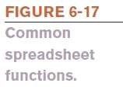
Spreadsheet Concepts
Function
A named, pre-programmed formula
Hundreds of functions that can be used in spreadsheets

Slide 34
Spreadsheet Concepts
Absolute vs. Relative Cell Referencing
Relative cell references
Cell addresses are adjusted as the formula is copied
Absolute cell references
Formulas are copied exactly as they are written
Appropriate when you want to use a specific cell
address in all copies of the formula
Use $ to make cell references absolute: $B$6

Slide 35
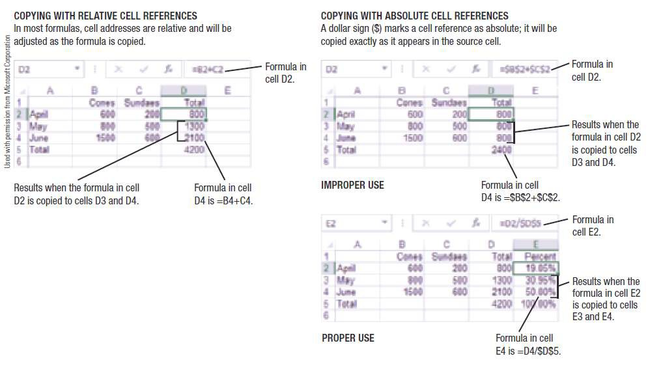

Spreadsheet Concepts

Slide 36
Spreadsheet Concepts
Charts and What-If Analysis
Most spreadsheet programs include some type of charting
or graphing capability
Can create charts from the data in the spreadsheet (do not have to reenter it)
Charts change accordingly if the data in the spreadsheet
changes
When cell contents are changed, formulas are
automatically recalculated
What-if-analysis
Tool frequently used to help make business decisions

Slide 37
Spreadsheet Concepts
Spreadsheets and the Web
Most spreadsheet programs have built-in Web capabilities
enabling the user to:
Save the current worksheet as a Web page
Insert hyperlinks inserted into worksheet cells
Select and copy ranges of cells to a Web publishing or word processing program to insert spreadsheet data into a Web page as a table
Send a workbook as an e-mail message
Collaborate online

Slide 38
Quick Quiz
Changing the line spacing of a document is an example of which word processing feature?
word wrap
editing
formatting
True or False: A label is a special type of named formula, such as SUM to add up a group of cell values.
A spreadsheet document created in a spreadsheet program is often called a(n) .
Answers:
1) c; 2) False; 3) worksheet

Slide 39
Database Concepts
What Is a Database?
A collection of related data that is stored in a manner
enabling information to be retrieved as needed
Database Management System (DBMS)
Software that allows the creation and manipulation of
an electronic database
Most widely used relational database programs
Microsoft Access
Oracle Database
IBM’s DB2
40

Slide 40
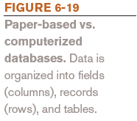
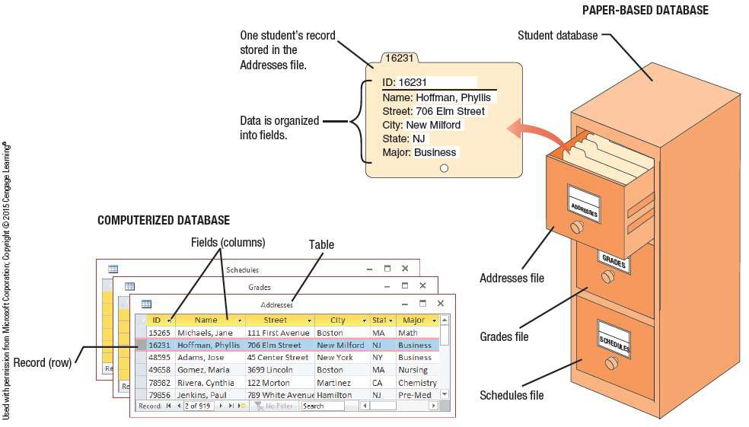
Database Concepts

Slide 41
Database Concepts
Data in a database is organized into fields (columns), records (rows), and tables
Field (column)
A single type of data to be stored in a database
Record (row)
A collection of related fields
Table
A collection of related records
Database file
Collection of related tables

Slide 42
Database Concepts
Creating a Database
Database file is created first
Contains objects, such as tables, forms, and queries
Tables can then be created
Typically, the table structure is specified first
Table structure includes:
Field name (unique identifying name)
Data type (text, number, date, object)
Field size (maximum number of characters)
Default value (initial content of the field)
The table is named and saved
Tables can be created in either Datasheet or Design view

Slide 43
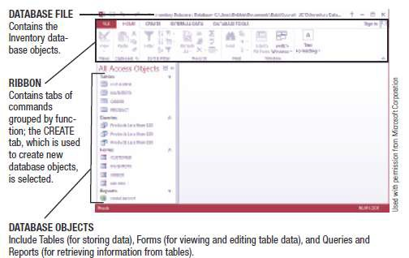
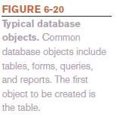
Database Concepts

Slide 44
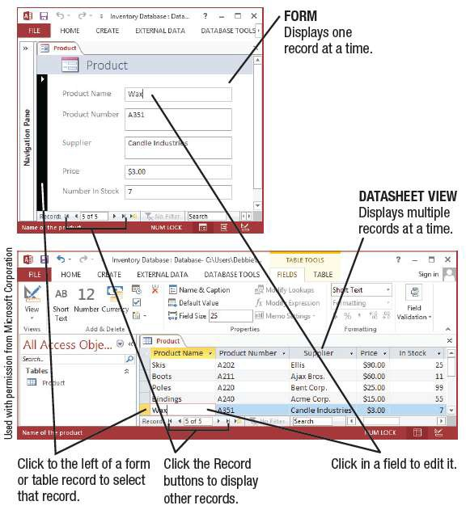

Database Concepts
Data can be displayed using a form or Datasheet view
Data can be edited

Slide 45
Database Concepts
Queries and Reports
Query
A question; a request for specific information from the
database
Contains criteria to specify the records and fields to be
included in the query results
Is named and saved so it can be run again at a later time

Slide 46
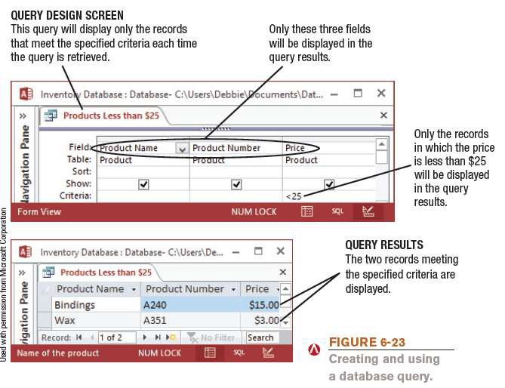
Database Concept

Slide 47
Database Concepts
Reports
Created when a more formal output is desired
Associated with either a table or a query
Data is displayed in the specified location
Databases and the Web
Many Web sites use one or more databases to:
Keep track of inventory
Allow searching for people, documents, products, or other information
Searching for products on a retail store’s Web site
Place real-time orders

Slide 48
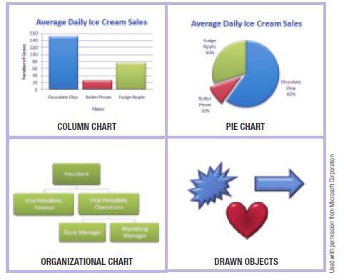

Presentation Graphics Concepts
What Is a Presentation Graphic?
An image designed to visually enhance a presentation
Can be used in electronic slide shows, as well as in printed
reports

Slide 49
Presentation Graphics Concepts
Slide
A one-page presentation graphic that can be displayed in a group with others to form an electronic slide show
Electronic Slide Show
A group of electronic slides that are displayed one after the other on a computer monitor or other display device
Presentation Graphics Software
Used to create presentation graphics
Most common presentation graphics programs
Microsoft PowerPoint
Corel Presentations
Apple Keynote
50

Slide 50
Presentation Graphics Concepts
Creating a Presentation
Preformatted slide layouts can often be used
New slides can be added to a new or existing presentation
as needed
Slides can contain a variety of elements
Text
Images
Charts
Audio clips
Video clips

Slide 51
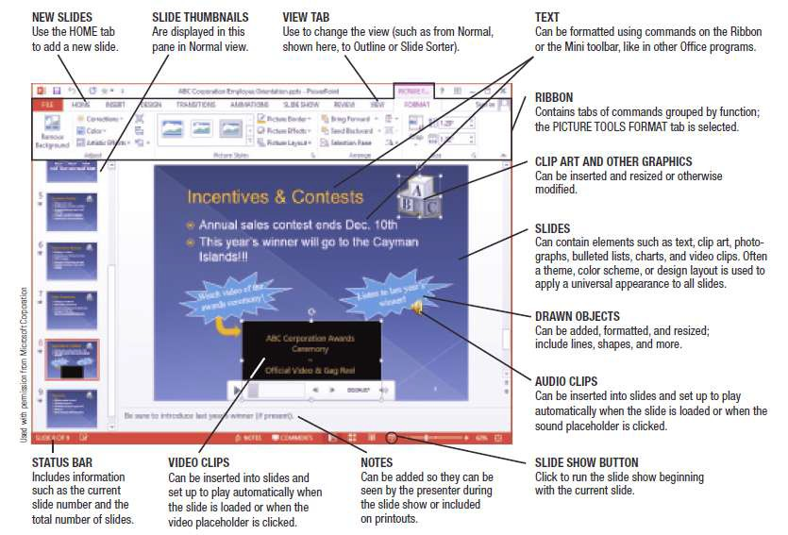

Presentation Graphics Concepts

Slide 52
Presentation Graphics Concepts
Finishing a Presentation
Slide Sorter View
Shows thumbnails of all slides in presentation
Used to rearrange the slide order
Show can be set up to run automatically or manually
Speaker Tools
Speaker notes and pens
Presenter view
Recorded narration
Can print the slides to create overhead transparencies or an audience handout

Slide 53
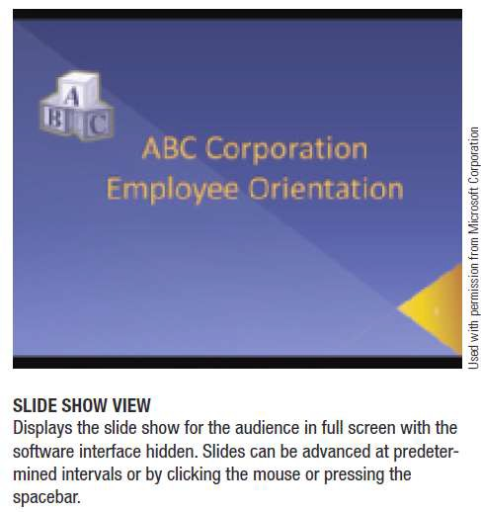
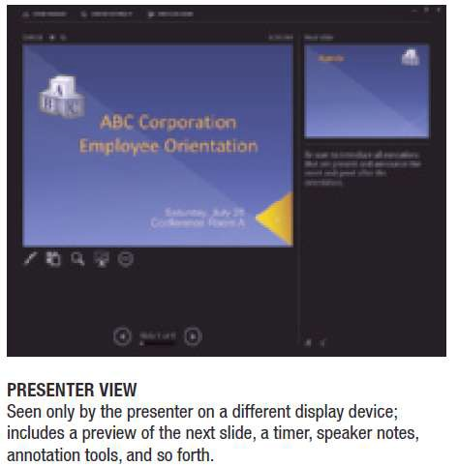

Presentation Graphics Concepts

Slide 54
Presentation Graphics Concepts
Presentation Graphics and the Web
Presentation graphics programs can be used to generate
Web pages or Web page content
Slides can include hyperlinks
Users can usually control Web-based presentations
accessed via a Web browser

Slide 55
Graphics and Multimedia Concepts
Graphics
Graphical images, such as digital photographs, clip art, scanned
drawings, and original images created using a software program
Multimedia
Technically refers to any application that contains more than one type of media
Often used to refer to audio or video content
Large variety of graphics and multimedia software used to:
Create or modify graphics
Edit digital audio or video
Play multimedia files
Burn CDs and DVDs

Slide 56
Graphics and Multimedia Concepts
Graphics Software (Digital Imaging Software)
Used to create or modify images
Painting Programs
Typically used to create bitmap images (Microsoft Paint)
Drawing Programs (Illustration programs)
Typically create images using mathematical formulas
Popular programs include Adobe Illustrator,
CorelDRAW, and Corel Painter

Slide 57
Graphics and Multimedia Concepts
Image Editing or Photo Editing Programs
Designed for touching up or modifying images
Correcting brightness/contrast
Cropping/eliminating red eye
Optimize file size for the Web
Adobe Photoshop, Apple iPhoto, etc.

Slide 58
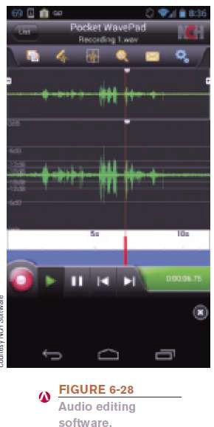
Graphics and Multimedia Concepts
Audio Capture and Editing Software
Used to create and edit audio files
Sound recorder software captures
sound from a microphone
Ripping software captures sound
from a CD
Edits and applies special effects
Common consumer products
Windows Sound Recorder, Apple GarageBand, Audacity

Slide 59
Graphics and Multimedia Concepts
Video Editing and DVD Authoring Software
Video Editing Software
Modifies existing videos
Prepares video clips for presentations or Web sites
DVD Authoring Software
Organizes content to be transferred to DVD
DVD Burning Software
Records data on recordable or rewritable DVDs
Common consumer video editing programs include Roxio Creator, Apple iMovie, etc.
60

Slide 60
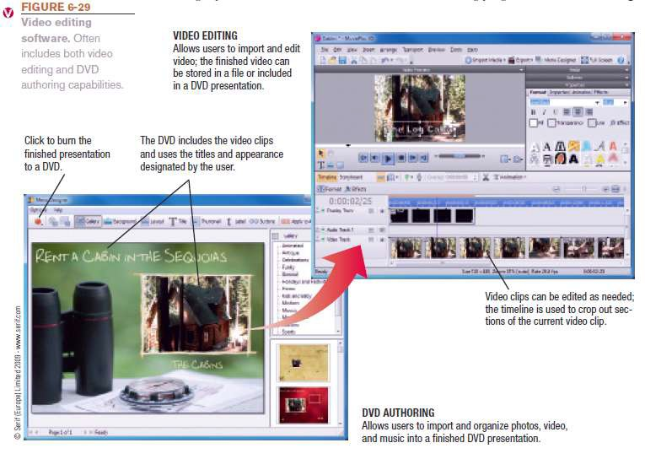
Graphics and Multimedia Concepts

Slide 61
Graphics and Multimedia Concepts
Media Players
Programs designed to play audio and video files
Music CDs, downloaded music, online audio
Downloaded and online video
Important to adhere to copyright laws when using digital
music
Media players include:
RealPlayer, Apple QuickTime, Windows Media Player,
etc.

Slide 62
Graphics and Multimedia Concepts
Graphics, Multimedia, and the Web
Often used by individuals and businesses to create Web
sites or content to be shared via the Web
Company logos
Web site banners
Games
Tutorials
Videos
Demonstrations
Other multimedia content

Slide 63
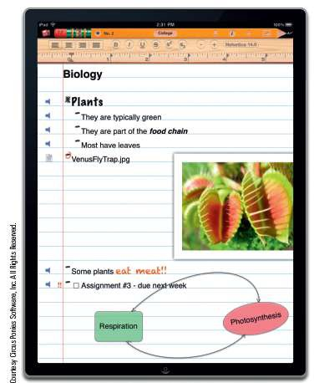

Other Types of Application Software
Desktop and Personal Publishing Software
Educational, Entertainment, and
Reference Software
Note Taking Software and Web
Notebooks

Slide 64
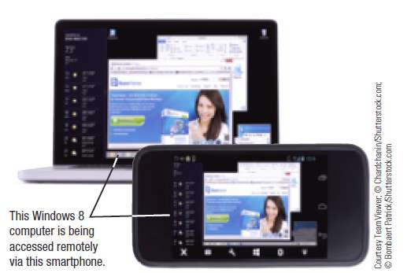
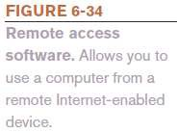
Other Types of Application Software
CAD and Other Types of Design Software
Accounting and Personal Finance Software
Project Management, Collaboration, and Remote Access
Software

Slide 65
Quick Quiz
A single type of data to be included in a database (viewed as a column in a table) is called a .
record
field
table
True or False: Each slide in a slide presentation can contain only one
type of element, such as text, an image, or a video clip.
Recording content on a CD or DVD disc is referred to as the disc.
Answers:
1) b; 2) False; 3) burning

Slide 66
Summary
The Basics of Application Software
Word Processing Concepts
Spreadsheet Concepts
Database Concepts
Presentation Graphics Content
Graphics and Multimedia Concepts
Other Types of Application Software

